Slide 1
Felician Mission: Haiti
FY20 Development Update
Marcia Wallander, Director of Development
January 30, 2020
Notes:
NOTE:
To change the image on this slide, select the picture and delete it. Then click the Pictures icon in the placeholder to insert your own image.

Slide 2
Felician Mission: Haiti Development Objectives presented in August 2019
Raise $2 million by June 2023
Determine annual fund need of Haiti and whether an endowment is needed for annual support.
Continue working with Sr. Marilyn and Sr. Inga to understand the needs of the mission and to work collaboratively on fundraising efforts.
Create stewardship and cultivation plans for current donors.
Provide updated information to donors regarding the impact being made in Haiti as a result of philanthropic support.
Create a pipeline of major gift prospects to increase number of major gifts to the campaign.
Create a solid base of annual fund donors.
Create a 3-year development plan for the FSNA Mission: Haiti.

Slide 3
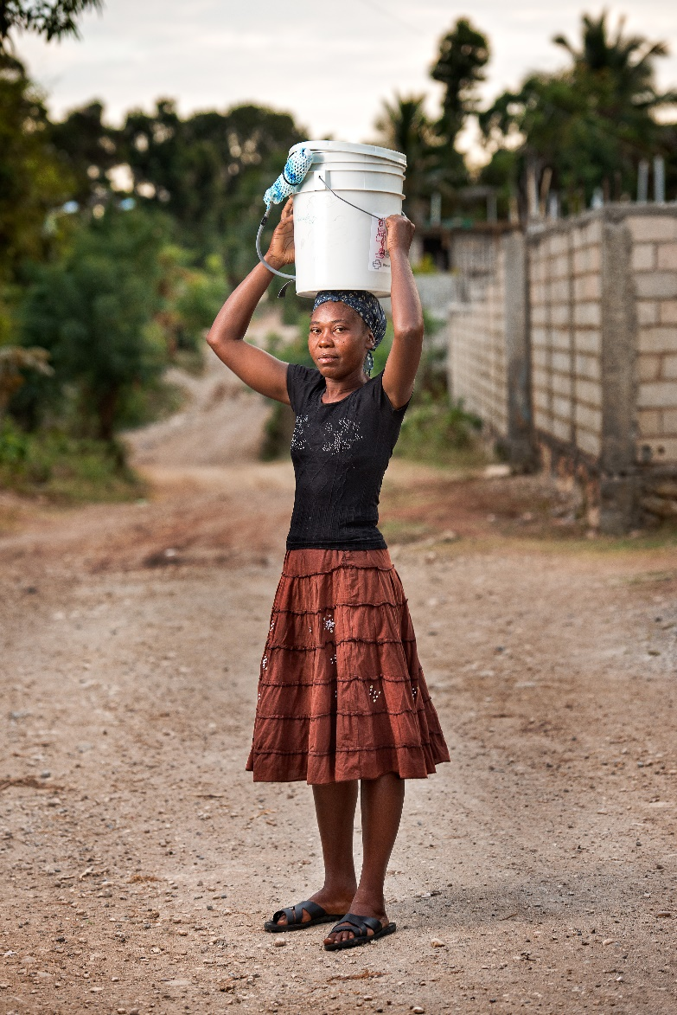
Felician Mission: Haiti Development Overview and Highlights
Completed strategic plan and budget
Created reply envelopes to be used in donor report, by Sisters during Mission Appeals in parishes and donor visits.
Created first donor report
Recommissioned Haiti video and made copies for distribution to increase awareness
Created new short video for social media, website and email
Created donor Committee in NJ to engage donors and to plan outreach and fundraising activities
Conducted two Stewardship Events
Created landing page for Haiti information at www.feliciansisters.org/haiti
Enhanced the Haiti blog to include history and giving options

Slide 4
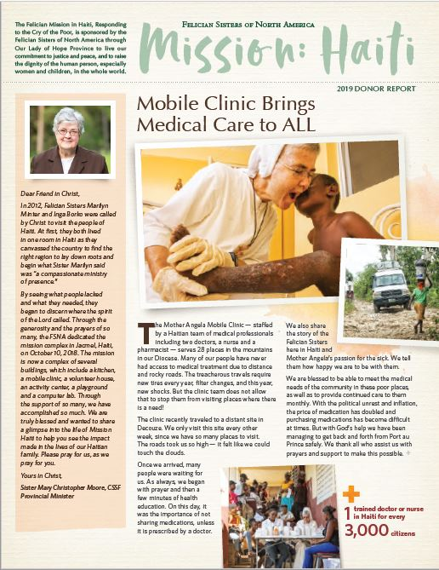
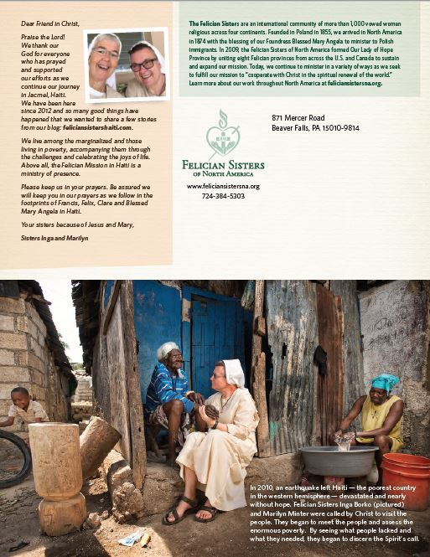
Felician Mission: Haiti 2019 Donor Report
Key Elements and Strategies
First update to all donors
Highlighted overview of all services
Created to be viewed by all audiences:
Pictures told the story
Fact Graphics highlighted the need
Story told the outcome
Letters from Srs. Christopher, Marilyn and Inga shared the history.
“Postcard” picture on the back set the stage
Explained the relationship of the Felician Sisters of North America to the mission
Overall Results
1,590 mailed to Haiti Donors: $12,270
5,000 mailed to non-Haiti Donors: $13,595
Total Giving: $25,865

Slide 5
Solicitation/ Fundraising

Slide 6
Giving Tuesday
Email-only campaign
3 targeted emails from presenting tangible giving opportunities
Campaign introduced by Sr. Christopher and followed up by Srs. Inga and Marilyn
$9,500 raised with average gift of $226
Link to blog and website to increase online giving

Slide 7
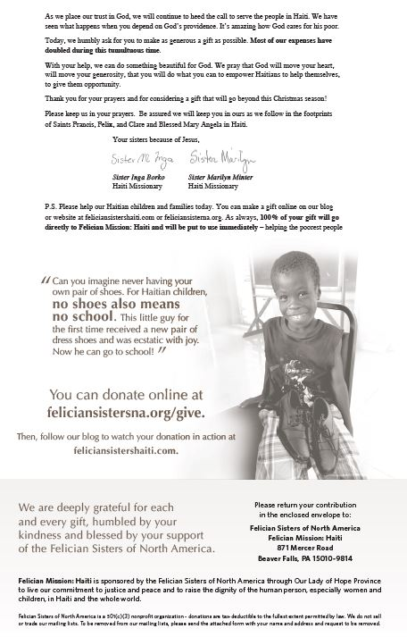
Direct Mail Campaign
10 targeted segments to:
Haiti Donors
Non-Haiti Donors
Non-Donors
Targeted ask amounts based on previous giving
Personal update on crisis from Srs. Inga and Marilyn
$33,620 raised to date

Slide 8
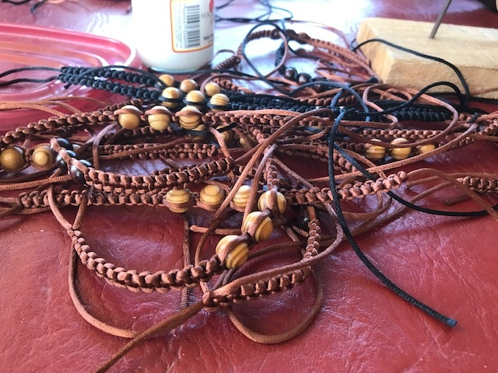
Acknowledgment Personalized Thank You Letters Prayer Bracelets

Slide 9
Engagement
Felician Mission: Haiti Development Committee
First meeting held in July and hosted by
Gavin and Marybeth O’Connor in Lodi, NJ

Slide 10
Stewardship
First Celebrate Mission: Haiti donor thank you events held:
Sunday, October 13, 2019 – Livonia, Michigan
Sunday, October 20, 2019 – Lodi, New Jersey

Slide 11
Stewardship
Front of card
Christmas Cards
Sent to all donors, from 2014 or later who gave $25 or more
Back of card

Slide 12
Communication/ Promotion
Felician Mission: Haiti
Website Landing Page
www.feliciansistersna.org/haiti

Slide 13
Communication/ Promotion
Felician Mission: Haiti Blog Update
Added giving option and informational tabs
About
How you can help
Our Work

Slide 14
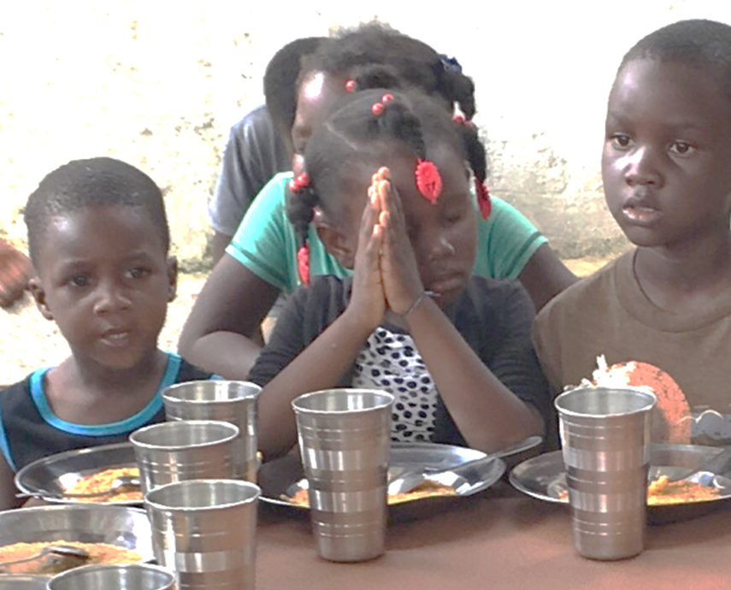
Results
Notes:
NOTE:
To change the image on this slide, select the picture and delete it. Then click the Pictures icon in the placeholder to insert your own image.

Slide 15
Giving to Felician Mission: Haiti by Calendar Year

Slide 16
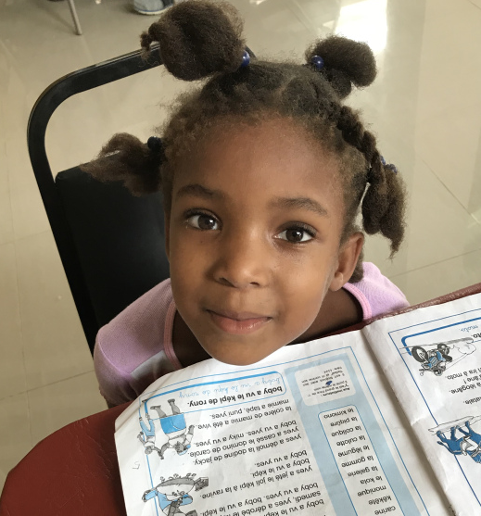
Fiscal Year Giving Comparison Giving to Date – January 28, 2020
Increase in donors as a result of increased direct mail opportunities.
GOAL: increase donors.
NOTE: 75% loss of donors over 5 years
Increase in giving and major donors.
GOAL: Build pipeline of major donors.
NOTE: Giving $100 or more can identify a major donor or planned giving opportunity.

Slide 17
FY20 December Direct Mail Results
Haiti donor response rate was 3x greater than Non-Haiti donors.
Rationale: Frequency -
they had 5 touches:
Haiti donor report
Haiti Celebration invite
Giving Tuesday email
Felician Magazine
Haiti Christmas card
They may know or have seen Srs. Marilyn or Inga at church.
They might subscribe to the Haiti blog.
They are informed!
Recent Haiti donors 7x more likely to give vs. donors who gave 1 year ago
Recent donors who just gave 2x more likely to give vs. donors who gave
Rationale: Recency – keeping in touch increases awareness.

Slide 18
Overall Revenue by Appeal as of January 14, 2020
Appeals help us understand how the money came in to provide us with the ability to evaluate fundraising initiatives.
Tracking individual asks
Coding envelopes in magazines, direct mail letters, giving programs at schools and parishes
Updated blog and website to increase online giving
Solicited Revenue for Felician Mission: Haiti
Category | Campaign | Appeal | Total Given | Avg/Gift | Note | Total Package
Capital Campaign | Haiti | Haiti Capital Cmpgn | $21,500.00 | $3,566.67
 | St. Mary Hospital Gala | SMMGALA19 | $1,150.00 | $383.33 |  | $3,950
Direct Mail | December Direct Mail | 10 packages | $20,705.00 | $316.67
 | Giving Tuesday | GivingTuesday2019 | $9,500.00 | $226.19 |  | $30,205
Grants | Grants | Grant Proposal | $50,000.00 | $50,000.00 |  | $50,000
Outreach | Giving Tree | Giving Tree | $4,391.00 | $88.35
 | Giving Treeq | Giving Tree | $1,475.00 | $86.76
 | Mission Appeal | Mission Appeal 19CCR | $4,875.00 | $348.21
 | Mission Appeal | Mission Appeal 19CSA | $11,680.00 | $115.64
 | Mission Appeal | Mission Appeal 19RSSS | $100.00 | $50.00 |  | $22,521
Stewardship | Acquisition - Haiti | Report to non-Haiti donors | $13,595.19 | $100.71
 | Felician Magazine | Autumn 2019 | $20,909.00 | $133.82 | (Not all Haiti)
 | Haiti Celebration | Livonia, MI | $1,415.00 | $283.00
 | Haiti Celebration | Lodi, NJ | $165,740.00 | $10,358.75
 | Haiti Stewardship | Donor Report 2019 | $12,270.00 | $201.15
 | Stewardship | Christmas Email 2019 | $10,260.00 | $176.90 | (Not all Haiti) | $224,189
TOTAL RAISED |  |  |  |  |  | $ 330,865

Slide 19
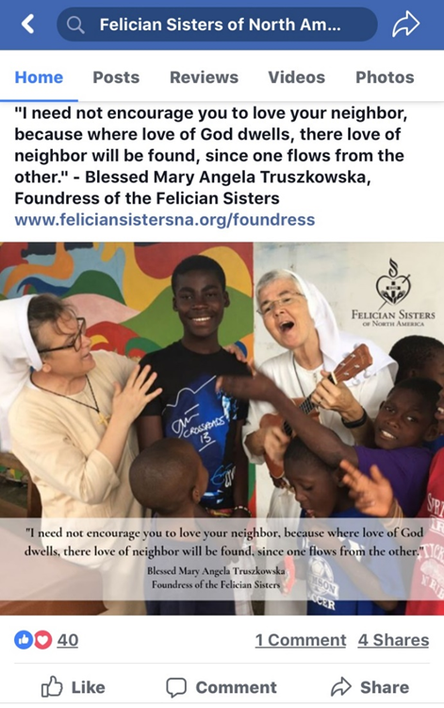
Felician Mission: Haiti Development Future Efforts
Outreach to parishes, schools and FSNA ministries
Focus on major gift donors
Direct Mail with a focus on a student story
Online market place giving
Grant opportunities
Social Media
Development Committee to plan outreach and fundraising activities
Create 3-year fundraising plan

Slide 20
Questions?
Notes:
NOTE:
To change the image on this slide, select the picture and delete it. Then click the Pictures icon in the placeholder to insert your own image.

